Slide 1
Sip & Serve
Moaid Gamer Eldawla

Slide 2
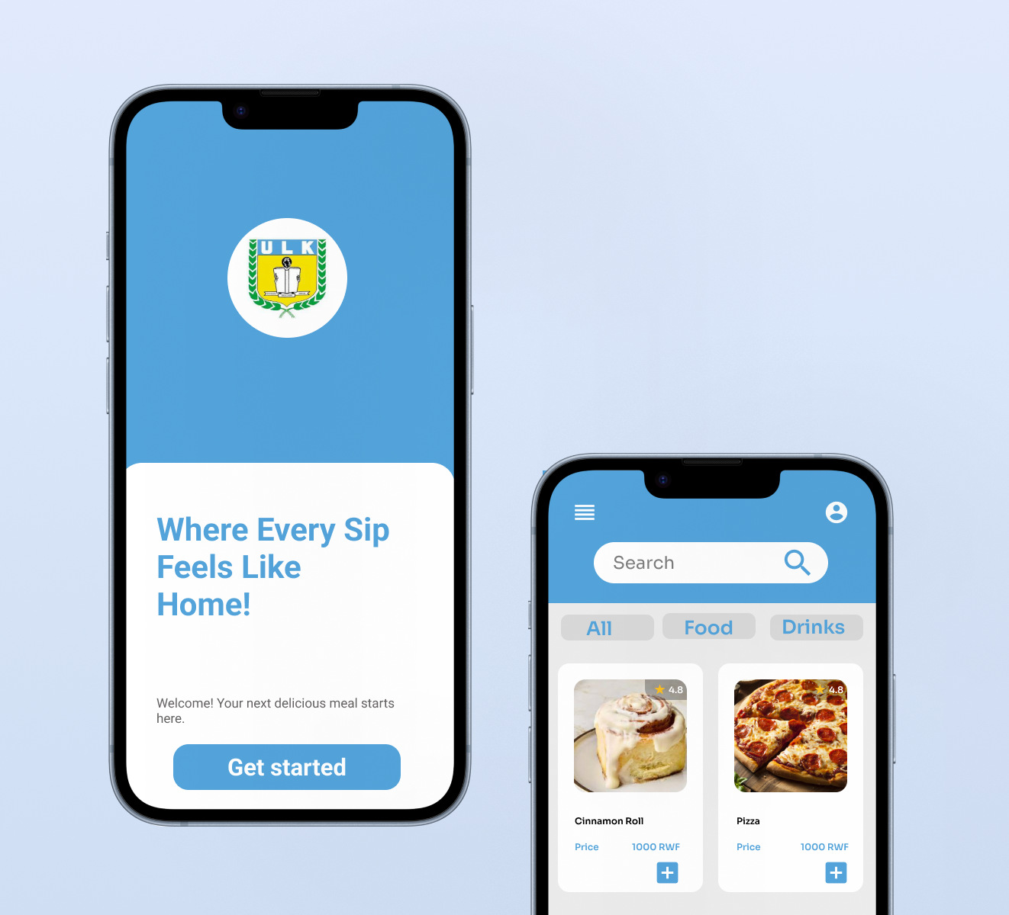
Project overview
The product:
Sip & Serve is a mobile food-ordering app designed for university students who want to save time and avoid long queues on campus.
The app allows users to browse updated menus, customize their meals, and place orders ahead for quick pickup.
It focuses on convenience, speed, and an easy user experience tailored for busy student life.
Preview of selected polished designs.
Project duration:
10/18/2025
10/21/2025

Slide 3
Project overview
The problem:
Students often waste time waiting in long queues at university cafés and restaurants.
They also struggle with outdated menus and lack of real-time order updates.
The goal:
To design a user-friendly app that allows students to order ahead, view real-time menus, and pick up their food quickly — improving convenience and satisfaction.

Slide 4
Project overview
My role:
UX Designer & Researcher
Responsibilities:
Conducted user research and interviews.
Designed wireframes and prototypes.
Tested usability and improved flow.
Created high-fidelity mockups.
Ensured accessibility and responsive design.

Slide 5
User research
Personas
Problem statements
User journey maps
Understanding
the user

Slide 6
User research: summary
I interviewed and surveyed 15 university students to understand their food-ordering habits and challenges.
Most users wanted a quick, reliable, and simple way to order meals without waiting or confusion.

Slide 7
User research: pain points
1
2
3
4
Pain point
Pain point
Pain point
Pain point
Long queues during lunch hours
No clear menu information or updates
Limited payment options​
​
No order tracking system

Slide 8
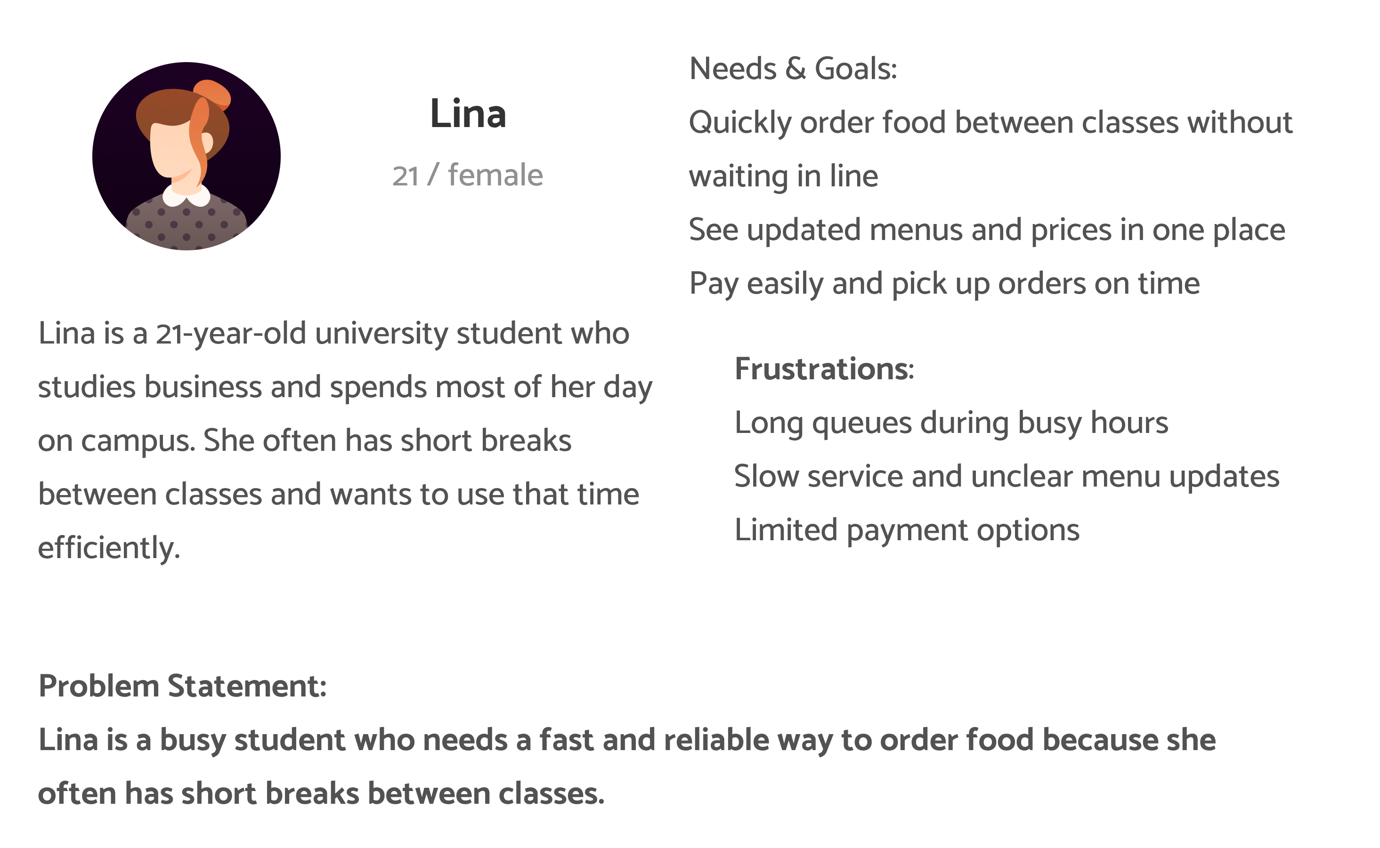
Persona: Lina
Problem statement:
Problem Statement: Lina is a busy student who needs a fast and reliable way to order food because she often has short breaks between classes.

Slide 9
User journey map
Stage | Action | Feeling | Pain Point | Opportunity
1. Before Ordering | lina is hungry and busy between classes | Stressed | No time to wait in line | Show menu + pre-order option
2. Opening App | Opens ULK Bites | Curious | May not know what to order | Add clear categories & images
3. Selecting Meal | Browses menu & adds items | Relaxed | Menu too long | Add favorites & search bar
4. Checkout | Confirms order & pays online | Confident | Payment delay | Add mobile money integration
5. Pickup | Gets meal instantly | Happy | None | Encourage feedback rating

Slide 10
The paper wireframes explored different layouts for the menu and checkout flow.
After user feedback, the final wireframe focused on clear navigation and fewer steps to complete an order.
Starting
the design

Slide 11
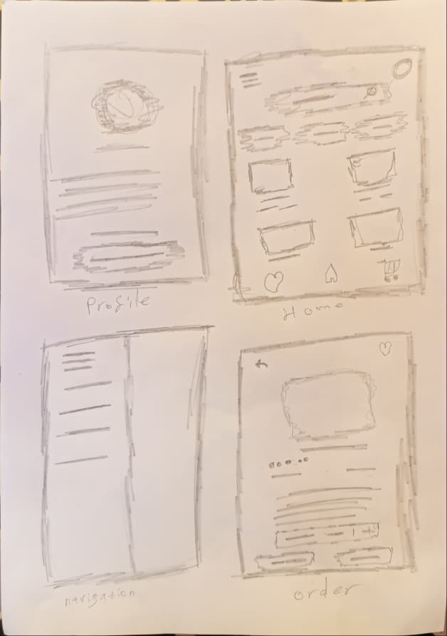
Paper wireframes
I drew several layout ideas for the main screens to test how users could order food easily.
Then I chose the clearest version with simple navigation and quick access to key features.

Slide 12
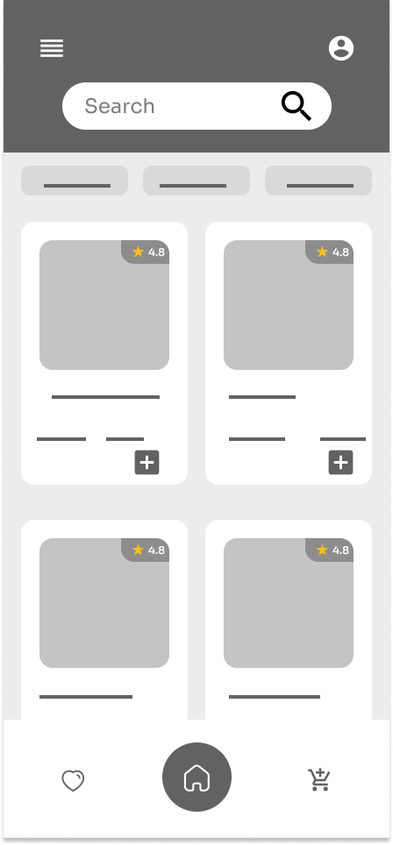
Digital wireframes
Digital wireframes showed the simplified flow from menu browsing to checkout.
The goal was to make ordering intuitive and visually clear for first-time users.

Slide 13
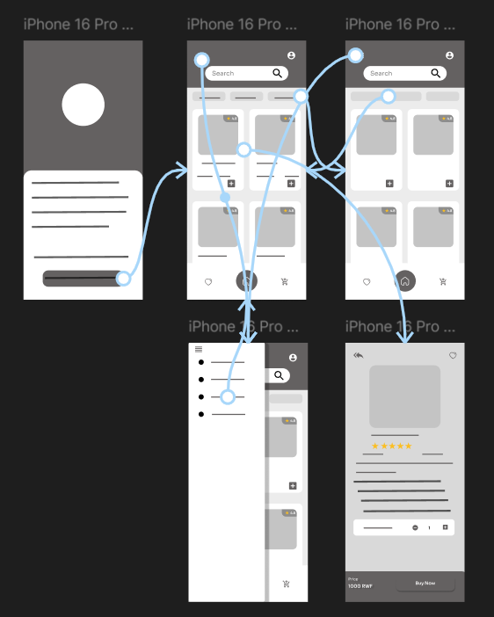
Low-fidelity prototype
A basic interactive prototype was created to test navigation and user flow before adding visual elements.

Slide 14
Usability study: findings
Users liked the clean layout and simple process but suggested clearer buttons and better menu visuals.
These insights helped refine the design for faster decision-making.
Round 1 findings
Round 2 findings
1
Users liked the simple layout and easy navigation.
1
Updated buttons and larger icons made the interface easier to use.
2
Some users said the “Order Now” button wasn’t visible enough.
2
Adding order tracking improved user satisfaction and confidence.
3
A few users wanted clearer food images and prices on the menu.
3
Shorter checkout steps made the process faster and more convenient.

Slide 15
Refining
the design
After usability feedback, the design was updated with brighter visuals, clear CTAs, and an improved checkout experience.
This version represents the final high-fidelity prototype.

Slide 16
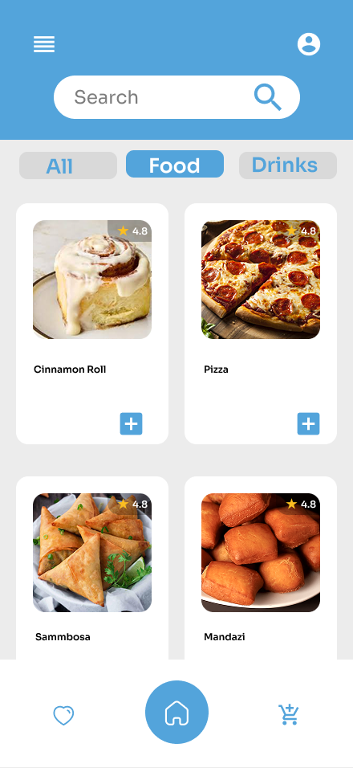

After usability study
Befor usability study​
Mockups
Before usability study
It was no price on the menu

Slide 17
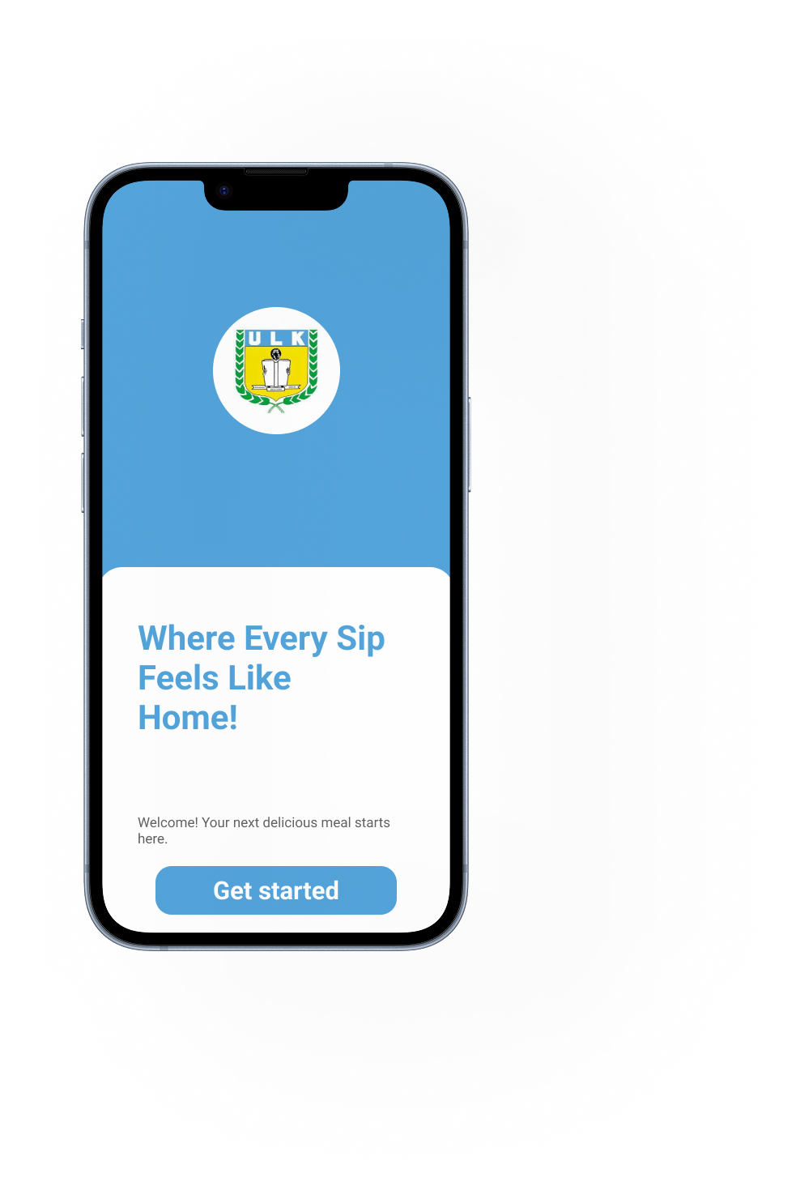
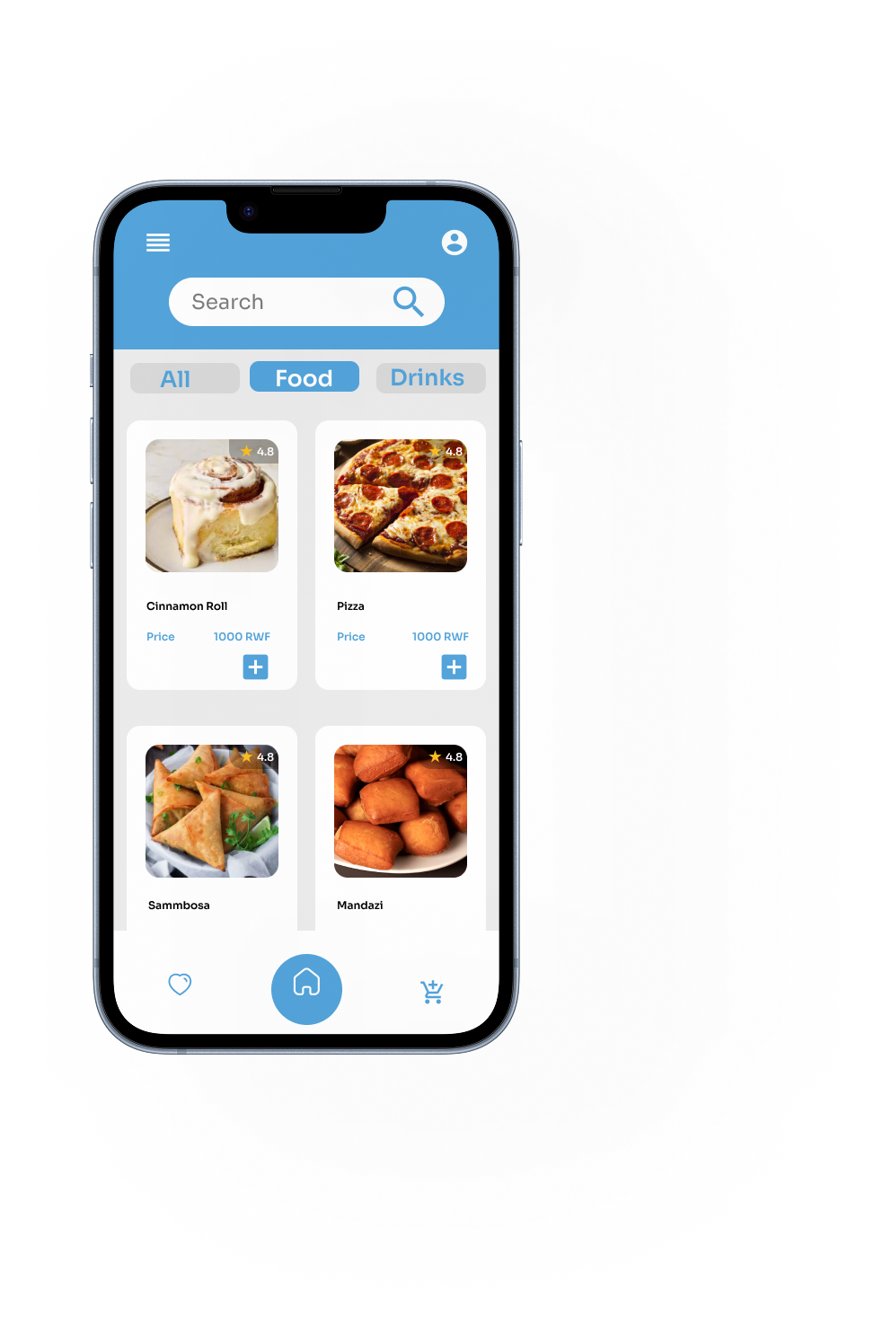
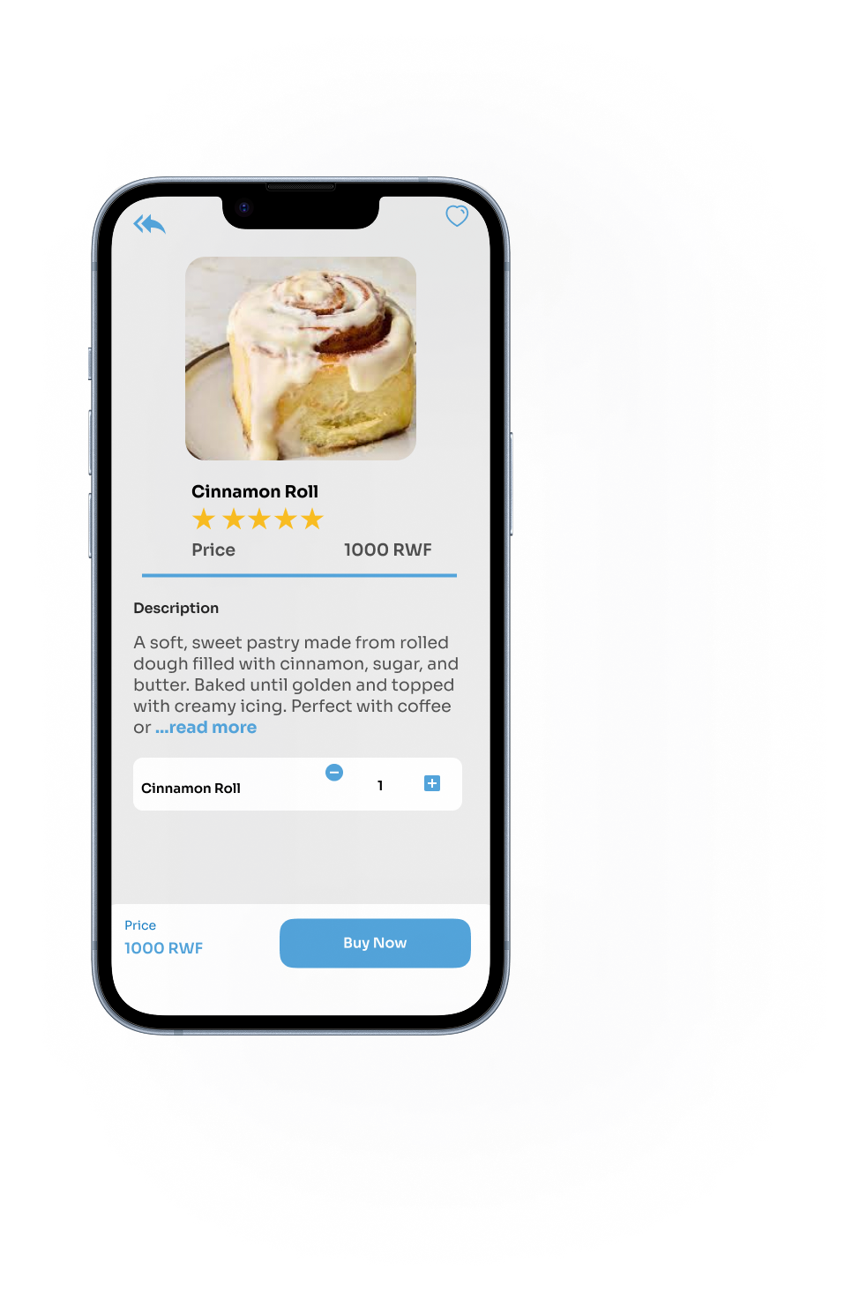
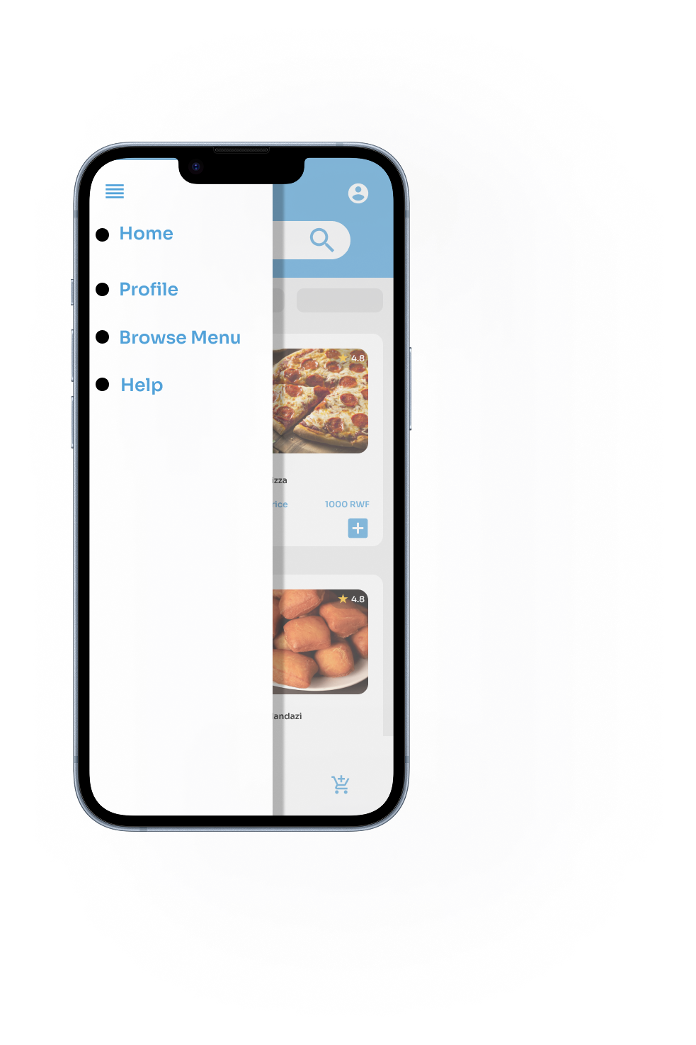
Mockups
Main mockup screen for display
Main mockup screen for display

Slide 18
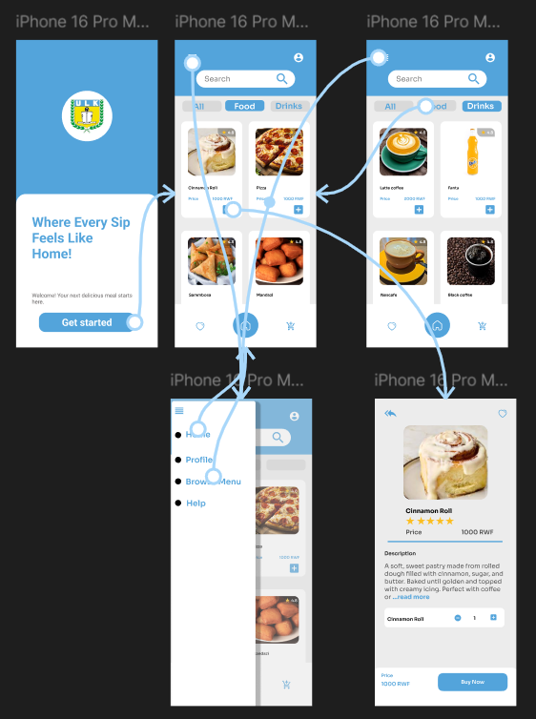
High-fidelity prototype
figma

Slide 19
Accessibility considerations
1
2
3
1. Used clear color contrast for better visibility
2. Added large, readable text for menu items
3. Ensured smooth navigation for assistive devices

Slide 20
Going forward
Takeaways
Next steps

Slide 21
Takeaways
Impact:
The app made food ordering faster and easier for students, reducing queue times and improving satisfaction.
What I learned:
I learned how early user testing and feedback can shape better product design and enhance usability.

Slide 22
Next steps
1
2
3
Add online payment and delivery tracking.
2. Expand menu filtering options.
Conduct another usability test with more participants.

Slide 23
Insert a few sentences summarizing the next steps you would take with this project and why. Feel free to organize next steps in a bullet point list.
Let’s connect!
Easily reach out, send messages, and get support whenever you need.
moaidgameer@gmail.com

Slide 24
Thank you!

